Slide 1

Nonprofit Funding Analysis
This presentation provides a comprehensive analysis of funding trends and distribution among nonprofit organizations in the United States. We analyzed data from over 200 organizations, representing a total funding flow exceeding $130 million. The analysis sheds light on key funding patterns, including mission type, geographic distribution, and funding efficiency. This information can be valuable for nonprofits seeking to optimize their fundraising strategies and for funders seeking to identify impactful organizations.
AY
by Abdul-Musawwir Yunus

Slide 2
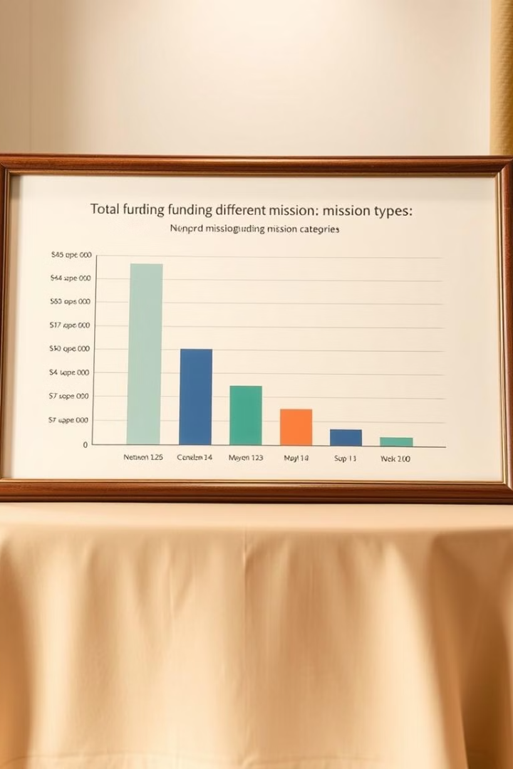
Executive Summary
1
Data Scope
2
Funding Flow
Our analysis encompassed data from over 200 nonprofit organizations across the United States, offering a broad perspective on the nonprofit funding landscape.
We analyzed a substantial flow of funding exceeding $130 million, providing insights into the distribution and utilization of resources in the nonprofit sector.

Slide 3

Methodology
Our analysis relied on a robust methodology incorporating advanced data analysis techniques. We collected data from a diverse range of nonprofit organizations, ensuring a comprehensive representation of the sector. To ensure data accuracy, we meticulously cleaned and processed the collected data, eliminating inconsistencies and errors.
We employed advanced AI algorithms and data analysis tools to extract meaningful insights from the cleaned dataset. These tools enabled us to identify key trends, patterns, and relationships within the data, providing a comprehensive understanding of nonprofit funding dynamics.

Slide 4
Funding Distribution By Mission Type
Mission Type
Funding Amount (Millions)
Education
69.8
Healthcare
65.7
Environmental
25.4
Food Security
22.3
Youth Development
20.5
Housing
18.5
Arts & Culture
17.8
Elderly Care
14.7
Veterans Services
13.6
Gender Equality
12.1
Humanitarian
10.5

Slide 5
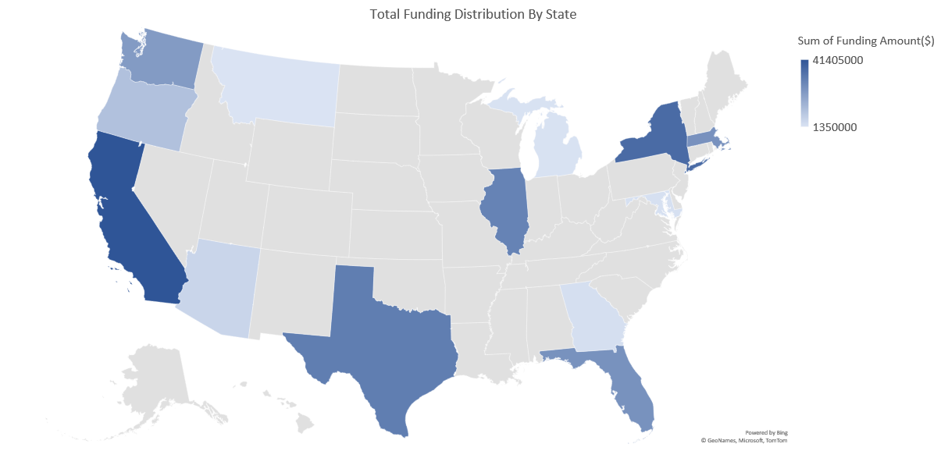
Geographic Analysis

Slide 6
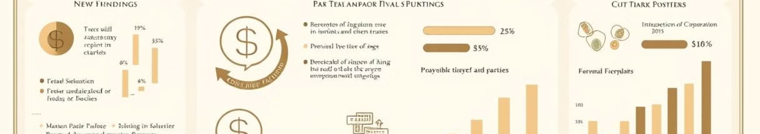
Top 3 States
Factors Influencing Distribution
The analysis reveals a significant geographic concentration of funding for nonprofits. California stands as the top recipient state with $41.4 million in funding. New York follows closely with $35.2 million, and Texas takes the third spot with $29.9 million.
Several factors contribute to this geographic variation in funding levels. These include population density, the presence of major urban centers, government policies supporting nonprofit organizations, and the economic vibrancy of each state. These factors influence the availability of philanthropic resources and the demand for nonprofit services within different regions.

Slide 7
Funding Efficiency Analysis

Slide 8



Scatter Plot Analysis
Correlation Analysis
Outlier Analysis
We conducted a comprehensive analysis of funding efficiency by examining the relationship between funding received and program service expenditure for each organization. This analysis is represented by a scatter plot, with funding amount on one axis and program service expenditure on the other.
The correlation analysis revealed a strong positive correlation of 0.999906, indicating a high degree of alignment between funding received and program service expenditure. This suggests that, in general, nonprofits in our analysis have effectively utilized the funding they received to provide services to their beneficiaries.
The scarcity of outliers on the scatter plot further substantiates this finding. While a few organizations may deviate from the general trend, the overall pattern indicates that the funding received has been effectively allocated towards program services.

Slide 9
Mission Type Breakdown
Row Labels
Arizona
California
Florida
Georgia
Illinois
Maryland
Massachusetts
Michigan
Montana
New York
Oregon
Texas
Washington
Grand Total
Arts & Culture
0.00%
0.66%
0.23%
0.00%
1.13%
0.00%
0.00%
0.00%
0.00%
0.20%
0.00%
0.21%
0.42%
2.84%
Education
0.00%
9.36%
2.34%
0.00%
0.83%
0.00%
10.62%
0.00%
0.59%
5.11%
0.00%
0.79%
0.81%
30.43%
Elderly Care
2.33%
0.00%
0.00%
0.00%
0.00%
0.00%
0.00%
0.00%
0.00%
0.00%
0.00%
0.00%
0.00%
2.33%
Environmental
0.00%
0.78%
0.77%
0.00%
0.00%
0.00%
0.00%
0.00%
0.00%
0.00%
3.82%
0.00%
1.93%
7.30%
Food Security
0.00%
1.72%
0.00%
0.39%
1.05%
0.00%
0.00%
0.46%
0.00%
1.14%
0.26%
2.11%
0.00%
7.12%
Gender Equality
0.00%
0.56%
1.08%
0.00%
1.05%
0.00%
0.00%
0.00%
0.00%
0.50%
0.00%
0.00%
0.00%
3.18%
Healthcare
0.00%
3.02%
2.86%
0.72%
6.48%
0.96%
0.00%
0.00%
0.00%
5.08%
0.73%
5.12%
3.69%
28.66%
Housing
0.00%
0.77%
1.15%
0.00%
0.00%
0.00%
0.00%
0.00%
0.00%
2.00%
0.00%
0.81%
0.38%
5.11%
Humanitarian
0.00%
0.00%
0.00%
0.00%
0.31%
0.00%
0.00%
0.00%
0.00%
0.34%
0.00%
0.67%
0.65%
1.97%
Veterans Services
0.00%
0.50%
2.13%
0.00%
0.00%
0.00%
0.00%
0.00%
0.00%
0.00%
0.00%
2.68%
1.60%
6.91%
Youth Development
2.33%
18.04%
0.00%
0.00%
1.57%
0.00%
0.00%
0.30%
0.00%
0.96%
0.00%
0.64%
0.00%
4.13%
Grand Total
4.66%
41.40%
10.56%
1.11%
12.42%
0.96%
10.62%
0.75%
0.59%
15.31%
4.81%
13.03%
9.49%
100.00%

Slide 10
Conclusion
Mission Type Distribution
Geographic Concentration
Funding Efficiency
Nonprofit organizations with missions focused on education and healthcare received the largest share of funding, exceeding $65 million each. This highlights the significant demand for services in these areas and the strong public support for organizations addressing these critical needs.
Funding is concentrated in specific geographic regions, particularly in California, New York, and Texas. This can be attributed to factors like population density, government policies, and economic activity, which influence philanthropic giving and the demand for nonprofit services.
The analysis indicates high funding efficiency, with a strong correlation between funding received and program service expenditure. This suggests that nonprofits in the analysis have effectively allocated resources towards fulfilling their mission goals.

Slide 11




Recommendations
Targeted Fundraising
Geographic Diversification
Data-Driven Approach
Collaboration and Partnerships
Nonprofits should focus their fundraising efforts on areas of greatest need, aligning their fundraising strategies with the priorities of potential funders. This includes identifying high-impact programs and showcasing their success stories to attract funding.
Nonprofits should consider expanding their geographic reach to tap into diverse sources of funding. This may involve partnering with local organizations in new regions, seeking grant opportunities in different states, or establishing regional chapters to increase their fundraising base.
Nonprofits should leverage data analytics to track their fundraising performance, identify trends, and optimize their strategies. This involves collecting and analyzing data on donor demographics, giving patterns, and program outcomes to refine their fundraising efforts.
Nonprofits should explore collaboration opportunities with other organizations to expand their reach, enhance their impact, and share resources. This includes partnerships with other nonprofits, businesses, and government agencies to leverage collective resources and address shared goals.

Slide 12

About the Author
Yunus Abdul-Musawwir is a data analyst and researcher with a deep understanding of the nonprofit sector. He has extensive experience in conducting data analysis, developing research reports, and providing insights to nonprofit organizations seeking to improve their fundraising strategies. His passion for social impact drives his commitment to supporting the work of nonprofits through data-driven analysis and insightful recommendations.

